Slide 1
I. Brief introduction
Several questions to ask in this course:
  1. What is the objective of the course - “introduction to
  crystal structure and diffraction theory”?
  (a) Crystal structure
  (b) Diffraction theory and techniques
  2. What is the atomic arrangement in a crystal?
  3. What is the crystal symmetry?
  4. What is the difference among reflection, refraction,
  and diffraction?

Slide 2
  5. How many kinds of diffraction techniques useful for
  materials characterization?
XRD (X-ray diffraction; bulk)
--- used for bulk structure determination (in air)
LEED (low energy electron diffraction; surface)
--- used for surface structure determination in UHV
(ultra-high vacuum)
RHEED (Reflection high energy electron diffraction)
--- equipped in MBE (molecular beam epitaxy,
UHV, surface)
TEM (Transmission electron microscope; bulk, thin)
--- used for chemical and structure determination

Slide 3
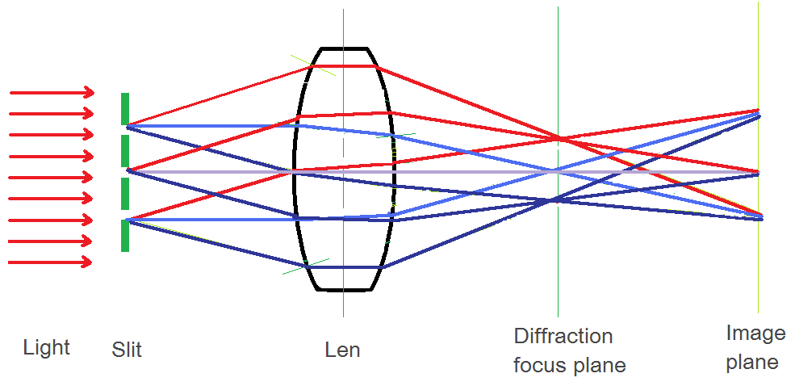
  6. What is the relationship between diffraction and
  image formation?
--- the image of the object is contained in each
diffraction spot
--- diffraction focal plane and image plane

Slide 4
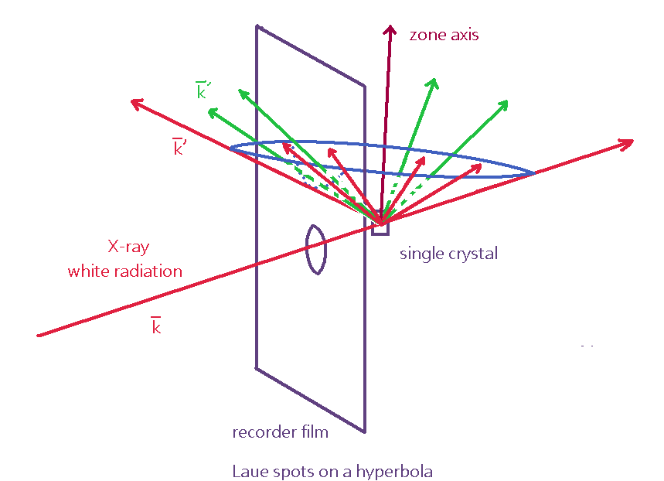
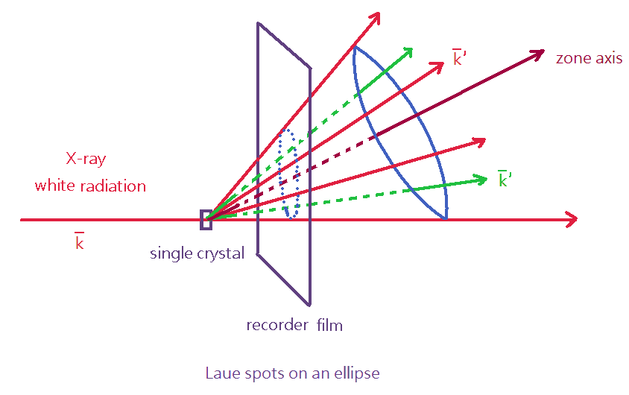
  7. What are the diffraction techniques covered in the text?
  (a) X-ray diffraction (XRD)
  ---- Laue method (orientation determination)
Transmission
Reflection

Slide 5
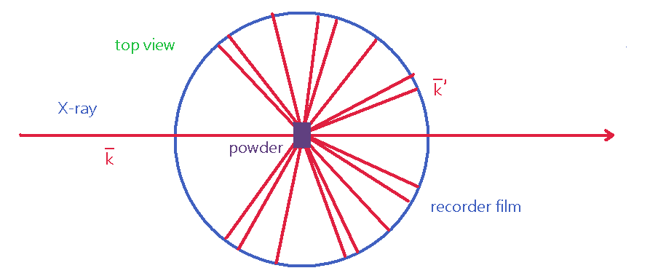
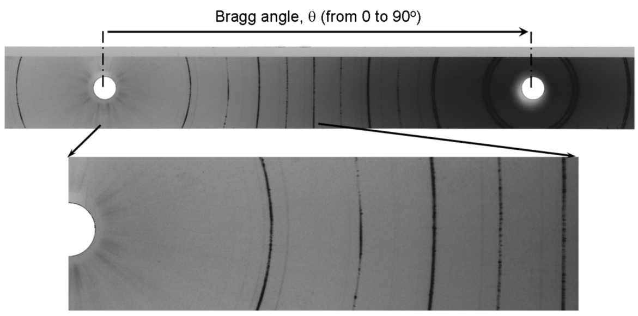
  ---- Debye-Scherrer Method (crystal structure
  characterization)
http://www.stanford.edu/group/glam/xlab/MatSci162_172/LectureNotes/06_Geometry,%20Detectors.pdf

Slide 6
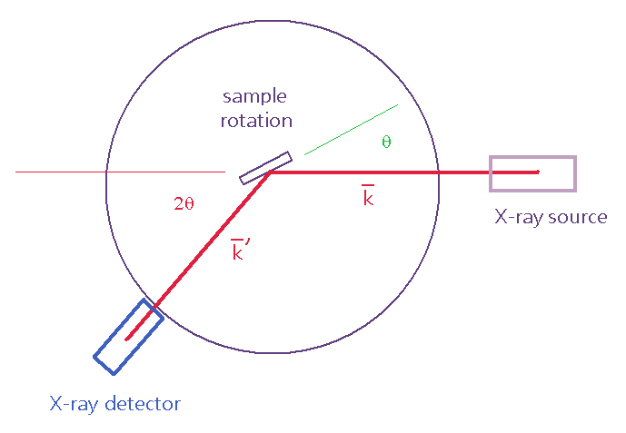
  ---- X-ray diffractometer (structure characterization)
  ---- X-ray topography (microstructure
  characterization)
  Each diffraction spot enlarged is actually a
  topograph.

Slide 7
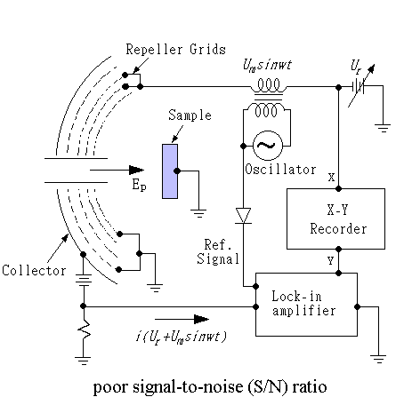
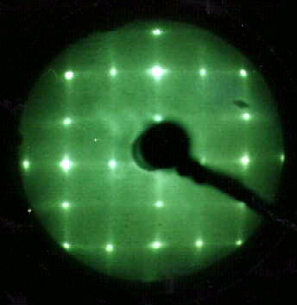
  (b) Low energy electron diffraction (LEED)
  ---- surface structure determination
LEED pattern of Si(100)2x1

Slide 8
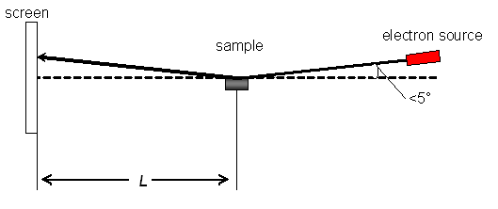
  (c) Reflection high energy electron diffraction
  (RHEED)
  --- used in MBE (molecular beam epitaxy)
Streaky RHEED pattern of an epitaxial layer

Slide 9
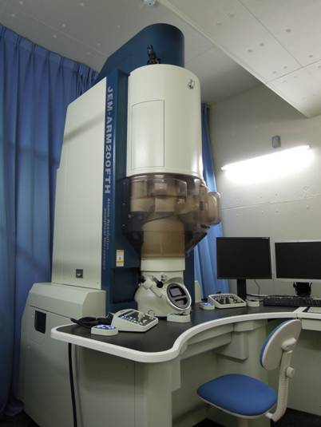
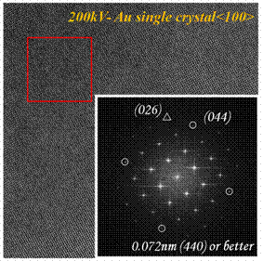
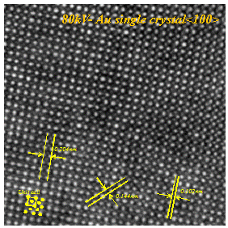
  (d) Transmission electron microscope (TEM)
--- structure, morphology, and chemical
determination (usually UHV, newest: liquid)
http://www.nscric.nthu.edu.tw/

Slide 10
